Slide 1

MBA Topic Modeling
Jatin Chanana
Upendra Karki
Erin O’Brien
David Torgerson
Notes:
Intro: Erin

Slide 2

What comes to your mind when you hear the word, “MBA”?

Slide 3


Problem Statement
In the Reddit thread, r/MBA, what are the top topics being discussed?
Drill into 1 topic?
What do prospective students consider?
What are the key topics surrounding MBA admissions?
Who are the key influencers that are talking about these topics?
Notes:
Erin

Slide 4

Data Collection
Data sources ruled out - Ps & Qs, GMAT Club, etc.
Collected data on Reddit - r/MBA
Used Reddit’s API and python to extract top 100 threads
Code snippet
What we’ve scraped, what we’ve yet to scrape
Extracted several variables
Heading
Comments
Usernames
Etc...
Notes:
Upen / Jatin
Maybe explain why you chose python over other tools
Talk a little bit about the code snippet (if you want to insert it)
Discuss the variables and why the variables are important?

Slide 5
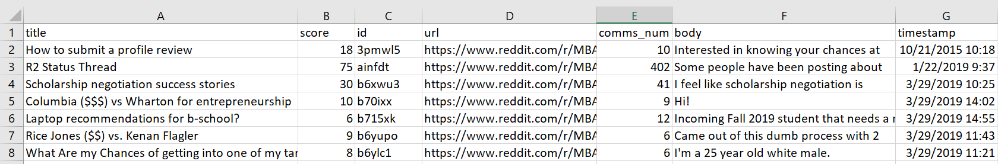
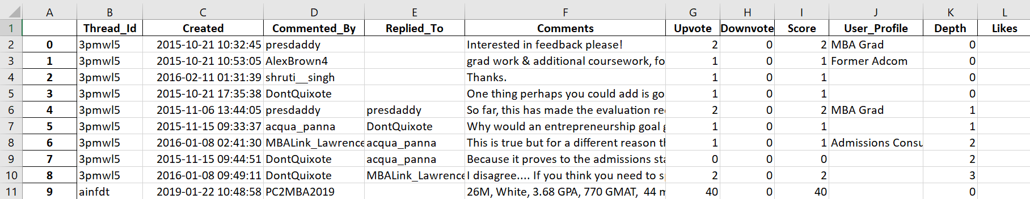
100 Post from Reddit- r/MBA community
Comments from each Post

Slide 6

Extract Important Information
First, let the data speak to us
Social Network and Cluster Analysis - using NodeXL
Identifying influencers
Identifying user clusters
Topic Modeling - LDA using python
Identifying topics
Notes:
David

Slide 7

Challenges
Pull and store topic/reply format - user/comment, user/comment
And retain discussion between vertices?
Deciding what comments to keep to provide insight into our problem statement.
“What would you do?”
Notes:
David

Slide 8

Questions, eh?

